Slide 1
RAILWAY TRACK HEALTH MONITORING BOT AMIT KADARMANDALGI 15BEC0146 KRISHNA IYER 15BEC0619 VIREN SUGANDH 15BEC0226 COURSE: Robotics and Automation(ECE2008)

Slide 2
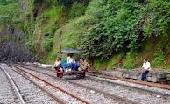
PROBLEM STATEMENT
India has the largest Railway network in the world.
Yet Nine (9) out of Ten (10) railway accidents during 2009-10 and 2014-15 have been due to derailments and accidents at level crossings.
The track inspection and monitoring is carried out manually

Slide 3
SOLUTION
In this project problem about a railway analysis is detection of cracks in the structure.
In this project, the proposed broken rail detection system automatically detects the faulty rail track without any human intervention.
There are many advantages with the proposed system when compared with the traditional detection techniques. The advantages include less cost, low power consumption and less analysis time.
By this proposed system the exact location of the faulty rail track can easily be located which could be mended immediately so that many lives can be saved.

Slide 4
PROJECT DESCRIPTION
The robot consists of Arduino taking input from sensors in a preference order (1)IR:To detect cracks acts as a filter for camera
(2)Camera: Detects if its a crack or a genuine gap in railway track.
The image processing part is done on matlab
Output would be sent in the form of a message using GSM module.
A separate GPS module is used to obtain latitude longitude based location of bot.
Further the motors will be controlled using L293D motor driver powered by 9V DC battery which will stop in presence of crack or obstacle.

Slide 5
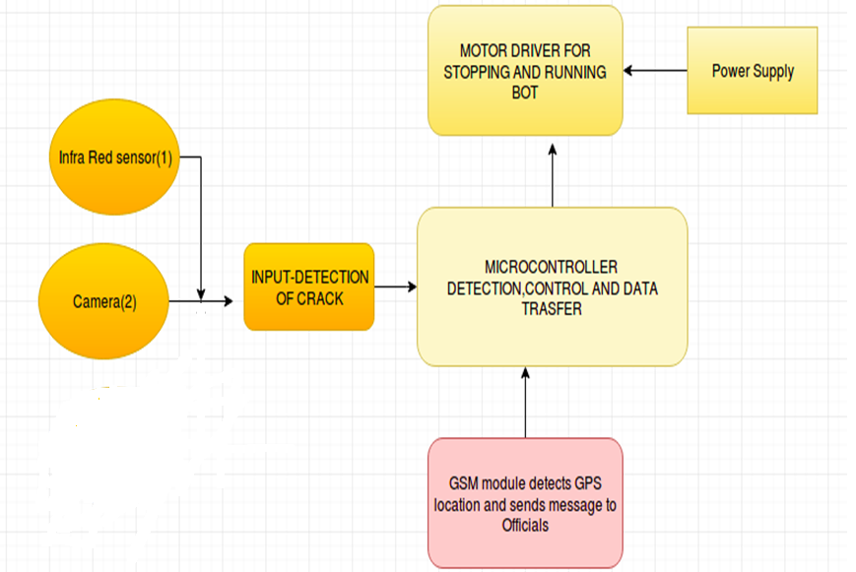

Slide 6
HARDWARE COMPONENT
Arduino uno
Breadboard
L293D Motor driver
2 Servo Motors,
IR Sensor
12V battery
Jumpers and wires

Slide 7
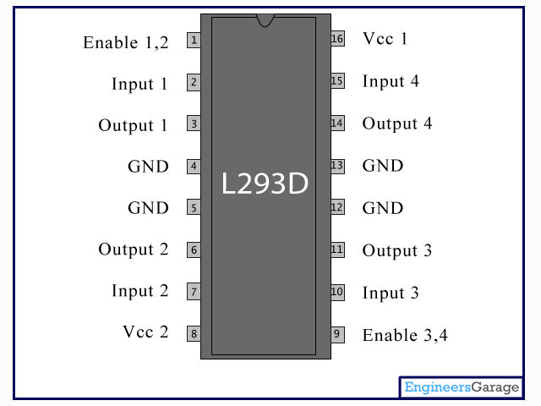
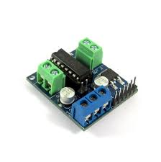
L293D motor driver
L293D is a dual H-bridge motor driver integrated circuit (IC). Motor drivers act as current amplifiers since they take a low-current control signal and provide a higher-current signal which is used to drive the motors.

Slide 8
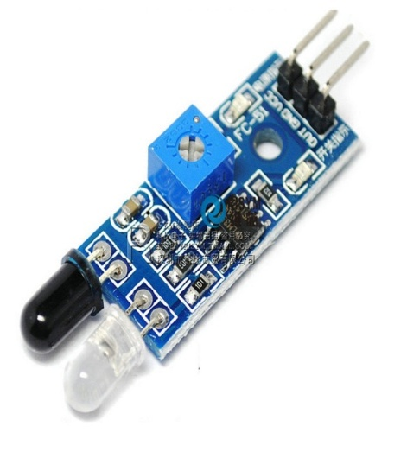
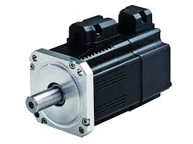
Servo motors:
Servo motors are the body of the robot that helps the bot to move. These are controlled using L293D motor driver connected to arduino and is powered by 9V battery.
IR Sensor :
These are the sensors we use as input to the system which helps to detect the crack. As the raillway track consists of shiny surface it allways reflects radiation hence giving outut 1 at IR and in presence of crack there will be no light reflecting hence gives 0 output.

Slide 9
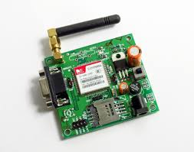
Gsm module
GSM module is used to detect gps location and to send the message to the office
GSM module was chosen because in india the telecom services are much better and efficient than internet services.
Hence preferably we can use networks than IOT

Slide 10
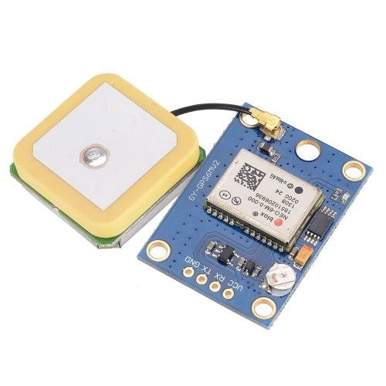
GPS module
GPS Module is a equipment which is used to measure a device’s geographical location
The GPS Module is used to calculate the latitude and longitude coordinates of the crack detected by the robot.
It is interfaced with an Arduino Uno in this project to obtain the number of locked satellites, the latitude and longitude coordinates of the crack.

Slide 11
HARDWARE IMPLEMENTATION
The IR sensor is connected to the Arduino Uno along with the GSM module.
The Arduino module is coded in a way such that when the output of the IR sensor becomes low, the GSM module sends a message to the user.
The GPS module has been configured to provide the location of the crack detected.
The Camera module has been attached to the robot to capture the image of the crack so that it can be processed in MATLAB.

Slide 12
SOFTWARE DESCRIPTION
The sensor coding is performed in embedded C using Arduino Uno Ide.
Image processing is done on matlab.
For sms and location GSM and GPS module has to be integrated with arduino respectively.

Slide 13
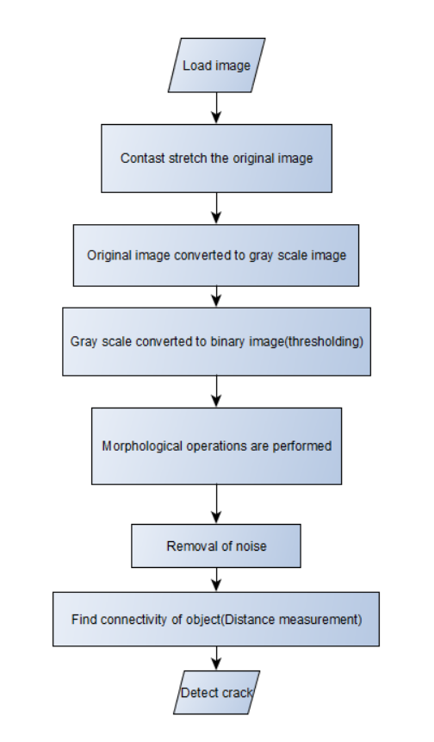
IMAGE PROCESSING
Basic Algorithm Implemented :

Slide 14
WORKING
Contrast sketch the original image.
The original image is converted to grey scale image.
Image luminous level is increased and the image is converted to binary image.(Image segmentation by thresholding)
Morphological operations are performed such as i) Cleaning ii) Thinning iii) Filling
The holes are filled so that it helps reject smaller objects which are not required for crack detection.
This helps in detecting only the cracks and removing other unwanted objects.
Filtering is applied to remove noise from the image. Noise removal helps in accurate detection.
The length of the crack can be determined upon calibration of image and using the imtool for the pixel length.

Slide 15
Crack length calculation-Algorithm
The binary image should be skeletonized.
From the following output image we can acquire all the center lines of the crack.
The length of the crack is estimated in pixels.
The crack lengths are extracted into an array. Each individual crack will have array.
The Total crack length will be equal to the sum of all the cracks.

Slide 16
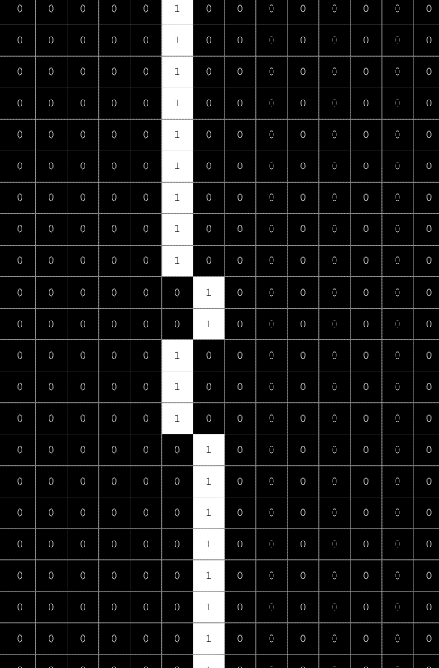
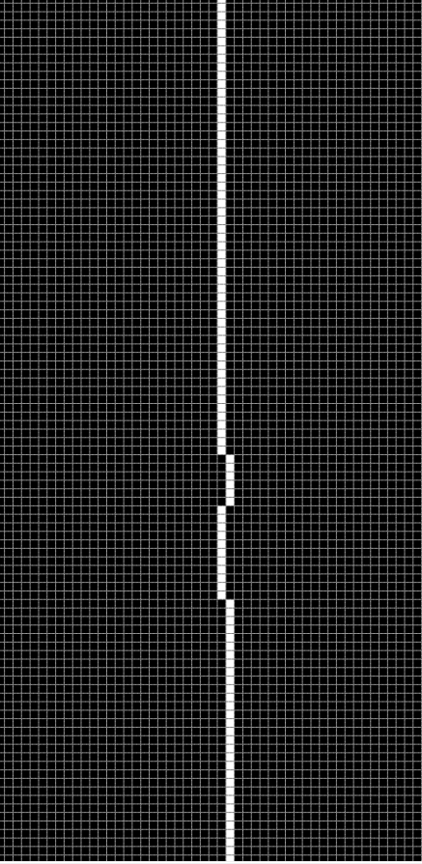
Calculation of length from pixels.

Slide 17
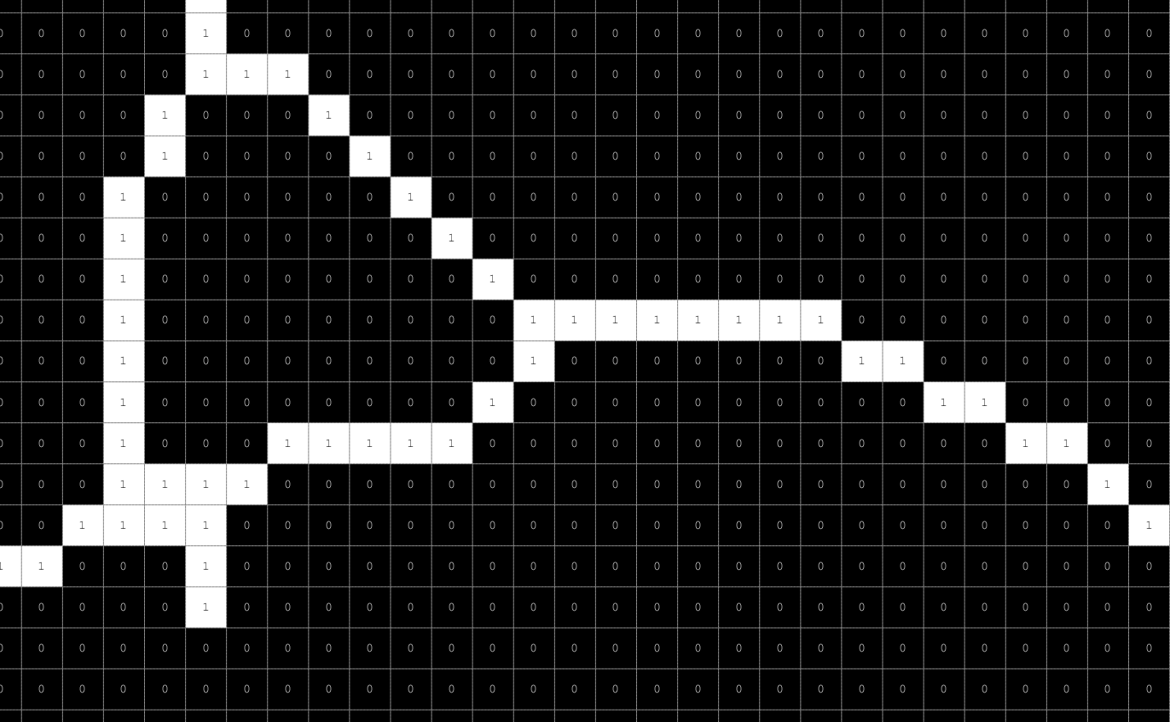
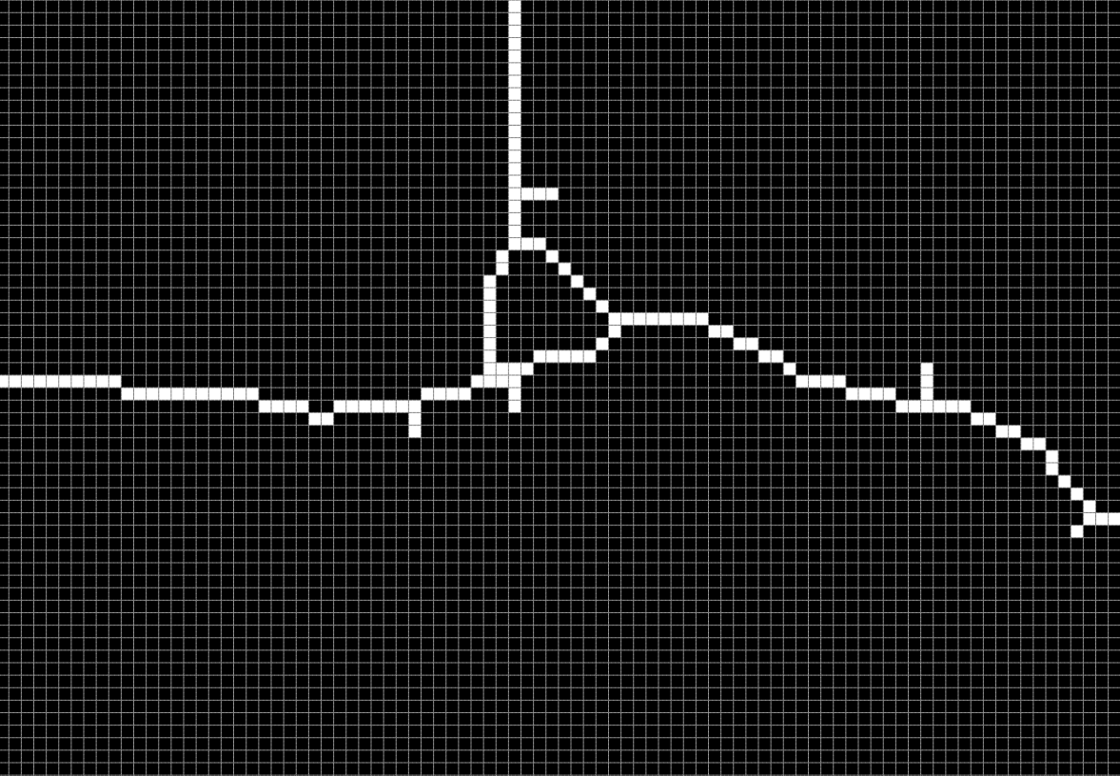

Slide 18
THANK YOU

